Slide 1
geomicrobiology

Slide 2
Where do microbes live in the environment?

Slide 4
How do microbes stick to a surface?
Physical attachment
Holdfast : specific organelle for attachment
Pili
Fimbriae, glycocalyx, stalk
Charge association

Slide 5
Surface charge governs interactions
“electric double layer”
Stern: inner layer of + ions
Cell surface is –
Guoy: counter-ions

Slide 6
Net charge of cell
“zeta potential”
In electric field, microbes typically move towards positively charged cathode
Influenced by pH
pH where movement stops, microbial isoelectric point

Slide 7
How do 2 negatively charged surfaces interact?
Low ionic strength environment
High ionic strength environment
DLVO theory: layers of cations

Slide 8
Metal sorption
Due to electrostatic interaction
Saturates at some point

Slide 9
Not all microbe:metal interactions are passive
Siderophores
Secreted by microbes to gather iron
3 main ways:
A: ligand in
B: trade ligand
C: switch to FeII

Slide 10
Biomineralization
Microbes can make or break minerals
Diatoms make opal from silica
Coccolithophores make calcium carbonate

Slide 12
Table 1. Some carbonate-containing minerals potentially formed by biomineralization. The solubility constants K_{sp} were calculated, except the measured value for natron (Morse and Mackenzie 1990). The maximum soluble concentration data are from (Weast 1987). Above the maximum concentration at 20 ºC, the mineral precipitate. See the main text and (Konhauser 2007) and (Ehrlich and Newman 2009) for information about the microbes potentially involved in forming these minerals.
Mineral | Formula | --log(K_{sp}) | Max Soluble Conc (g Liter⁻¹) | Microbes
Calcite | CaCO₃ | 8.30 | 1.4 | Cyanobacteria
Aragonite | CaCO₃ | 8.12 | 1.5 | Cyanobacteria
Dolomite | MgCa(CO₃)₂ | 17.1 | <1 | Sulfate reducers
Magnesite | MgCO₃ | 8.2 | 10.6 | Actinomycetes
Natron | Na₂CO₃.10H₂O | 0.8 | 7100 | Sulfate reducers
Siderite | FeCO₃ | 10.5 | 6.7 | Iron reducers
Rhodochrosite | MnCO₃ | 10.5 | 6.5 | Mn reducers
Strontianite | SrCO₃ | 8.8 | 1.1 | Various

Slide 13
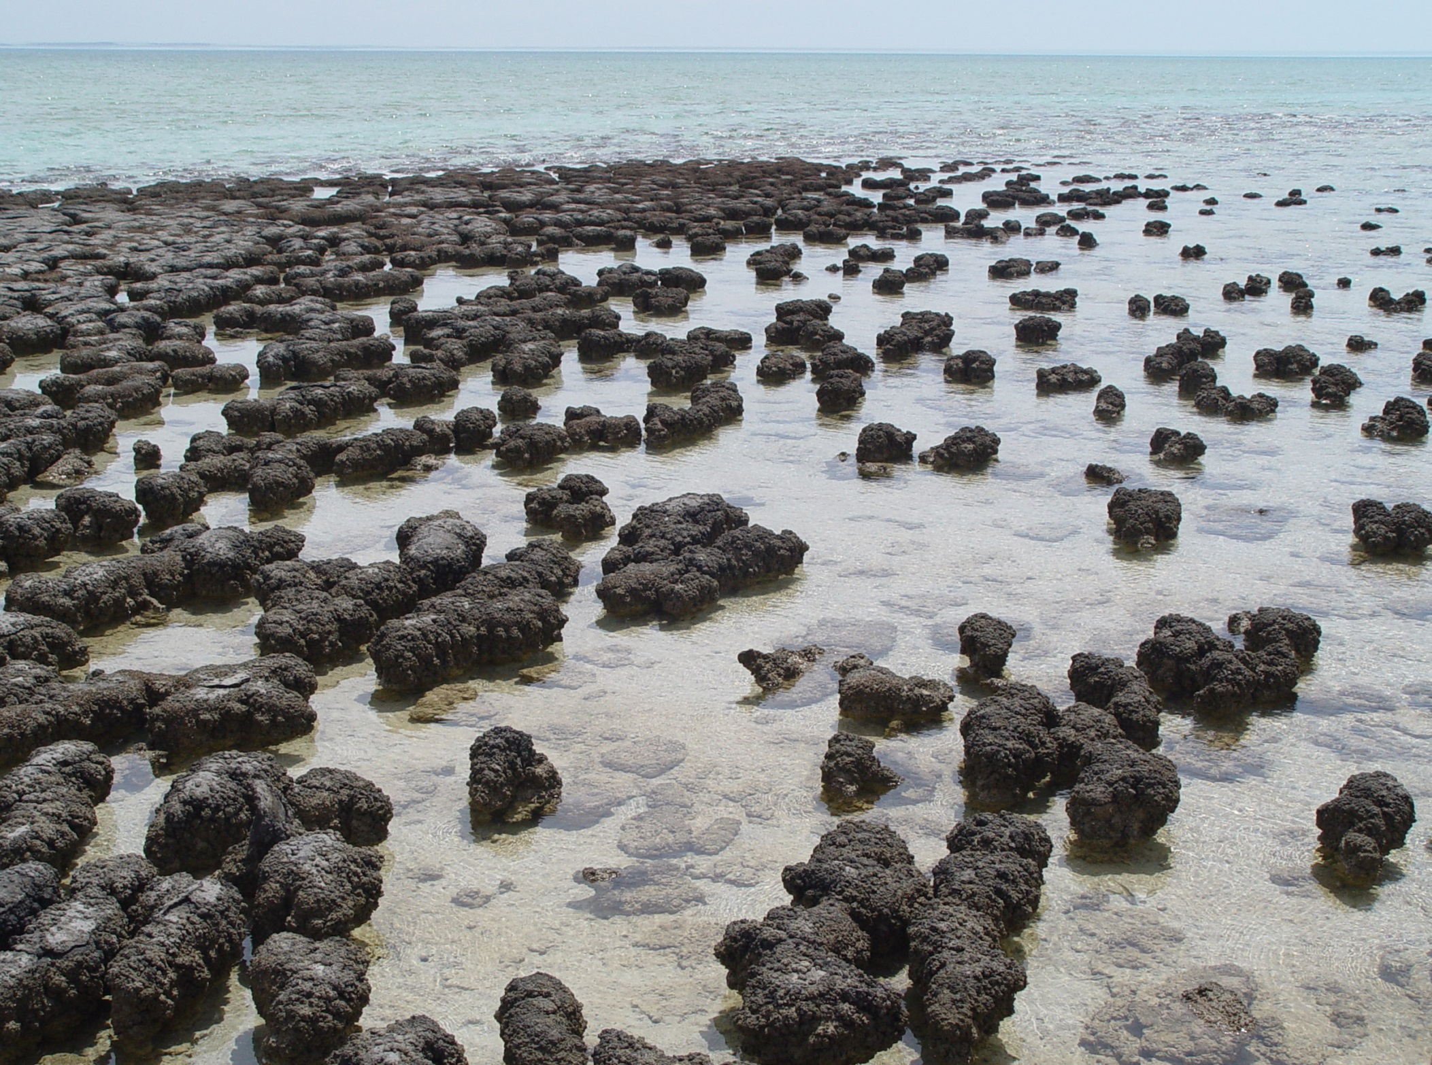

Slide 14
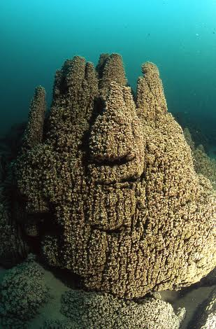
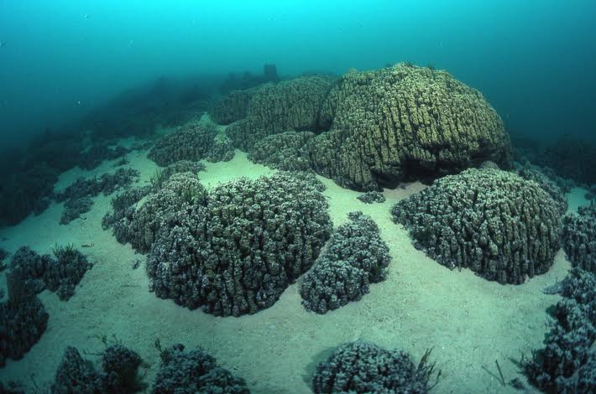
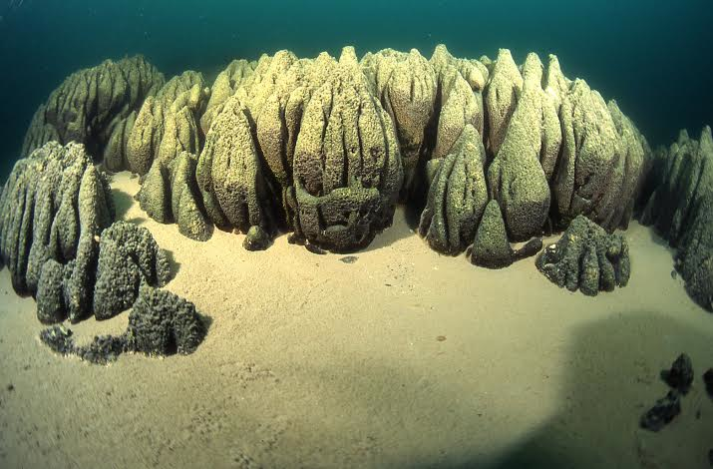
Microbialites

Slide 15
Microbialite formation
Stromatolite: layered
Thrombolite: disordered
How carbonate gets made:
pH effects
Trapping and binding by extracellular polymeric substances (EPS)

Slide 16
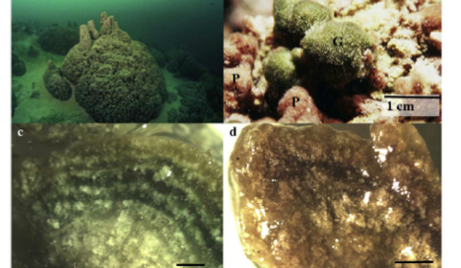

Slide 18
Apatite
Bone, tooth enamel
Connected to S oxidizers

Slide 19
Table 2. Some iron-rich minerals and possible connections to microbes. “Oxides” includes hydroxides.
Type | Mineral | Composition | Comments
Carbonate | Siderite | FeCO₃ | Fe(II) produced by iron-reducers
Oxides | Amorphous ferric hydroxide | Fe₂O₃ | No crystallinity, most easily used by iron-reducers
Oxides | Ferrihydrite | Fe₂O₃.0.5(H₂O) | Some crystallinity
Oxides | Hematite | Fe₂O₃ | Stable form of iron oxide
Oxides | Goethite | FeO(OH) | Stable form of iron oxide
Oxides | Magnetite | Fe₂O₄ | Produced by magnetotaxic bacteria
Sulfide | Pyrite | FeS₂ | Sulfide oxidizers
Sulfide | Greigite | Fe₃S₄ | Produced by magnetotaxic bacteria

Slide 20
Magnetosomes

Slide 22
ALH84001

Slide 23
iron-oxidizing bacteria
Key players in “acid mine drainage”

Slide 24
4Fe ²⁺ + O₂ + 4H⁺ →4 Fe³⁺ +2H₂O
FeS₂ + 14Fe³⁺ + 8 H₂O → 15Fe²⁺ + SO₄ ²⁻ + 16H⁺

Slide 26
Table 3. Some types of iron-oxidizing bacteria. The iron-oxidizers using nitrate as an electron acceptor are denitrifiers and produce N₂. The photolithotrophic iron-oxidizers use the electrons from ferric oxidation to reduce CO₂ and synthesize organic material autotrophically. The chemoorganotrophs oxidize iron but gain energy from the oxidation of organic material rather than from the iron. Based on (Canfield et al. 2005) and (Emerson et al. 2010).
Metabolism | Electron acceptor | Taxonomic classification | Example
Neutralophilic lithotrophy | O₂ | Betaproteobacteria | Gallionella
 |  | Zetaproteobacteria | Mariprofundus ferrooxydans
 | NO₃⁻ | Betaproteobacteria | Thiobacillus denitrificans
 |  | Alphaproteobacteria | FO1 and others*
 |  | Gammaproteobacteria | FO4 and others*
Acidophilic lithotrophy | O₂ | Nitrospira | Leptospirillum
 |  | Actinobacteria | Sulfobacillus
 |  | Crenarchaeota | Sulfolobus
 |  | Euryarchaeota | Ferroplasma acidarmanus
Chemoorganotrophy | O₂ | Betaproteobacteria | Leptothrix
 |  | Alphaproteobacteria | Pedomicrobium
Photolithotrophy | CO₂ | Alphaproteobacteria | Rhodovulum
 |  | Chloroflexi | Chlorobium ferrooxidans
*Several strains isolated from the Juan de Fuca hydrothermal vent were shown to use oxygen or nitrate as an electron acceptor (Edwards et al. 2003).

Slide 27
Microbial-aided weathering
Acid-production
Ligand-mediated
Base-production
Metabolic
Important for:
Monuments
Buildings
Concrete
General carbon cycle

Slide 28
Weathering reaction, which consumes CO₂
CO₂ + 2 H₂O + CaAl₂Si₂O₈ → Al₂Si₂O₅(OH)₄ + CaCO₃

Slide 29
Weathering by:
Acidity
Ligands
Iron Reduction
Hydroxides

Slide 30
Weathering by inorganic and organic acids

